Slide 1

Predicting Breast Cancer Patient Outcomes Using Machine Learning
Niyathi Lekkala, Vinod Kumar Kethavath
Leveraging machine learning models to enable early Diagnosis and Better clinical decisions in order to increase the survival rate of Breast cancer Patients.

Slide 2




Problem Statement & Objectives:
A research initiative addressing breast cancer's global mortality burden by developing machine learning models to predict survival outcomes and enhance personalized treatment strategies.
Global Impact
Clinical Importance
Project Goal
Breast cancer remains the leading cause of cancer-related mortality among women worldwide, with over 2.3 million new cases diagnosed annually
Accurate and timely survival predictions are crucial for optimizing personalized treatment strategies and improving patient outcomes
Develop and validate robust machine learning models to predict patient survival status(Alive or Dead) based on clinical, pathological, and demographic factors

Slide 3
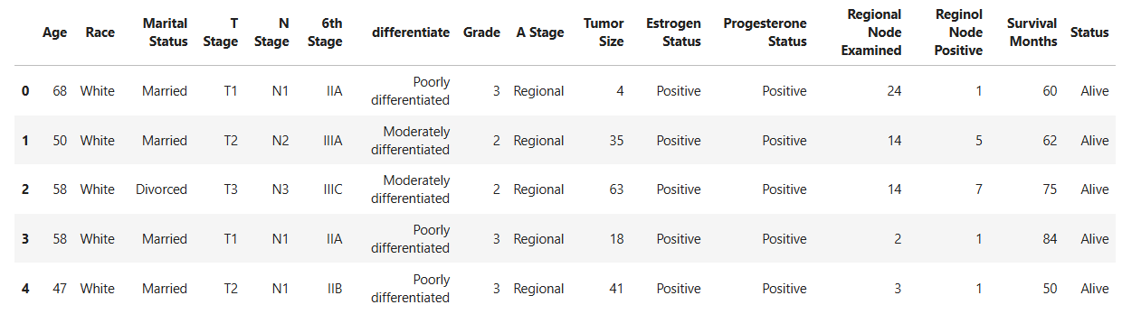
Exploratory Data Analysis:
Analysis revealed patient survival dataset with class imbalance requiring SMOTE correction and outliers in age, tumor size, and survival months variables that were successfully addressed using IQR methodology.
1. Dataset Overview:
2. Class Balance:
Significant imbalance detected between survival outcomes.
Applied Synthetic Minority Over-sampling Technique (SMOTE) to address class disparity and improve model training.
Target variable: Patient Status (1=Alive, 0=Dead)
Primary dataset contains demographic, clinical, and pathological features from breast cancer patients.

Slide 4
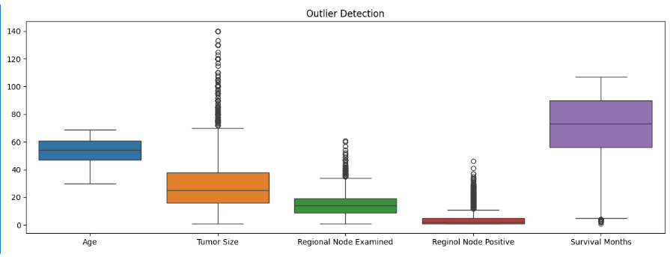
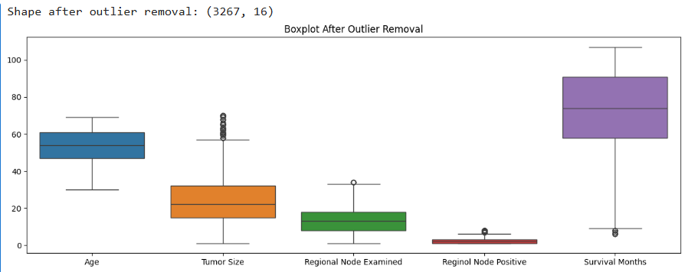
3. Outlier Detection:
Employed statistical boxplot visualization and Interquartile Range (IQR) methodology.
Successfully identified and addressed outliers in key variables: Age, Tumor Size, and Survival Months.

Slide 5
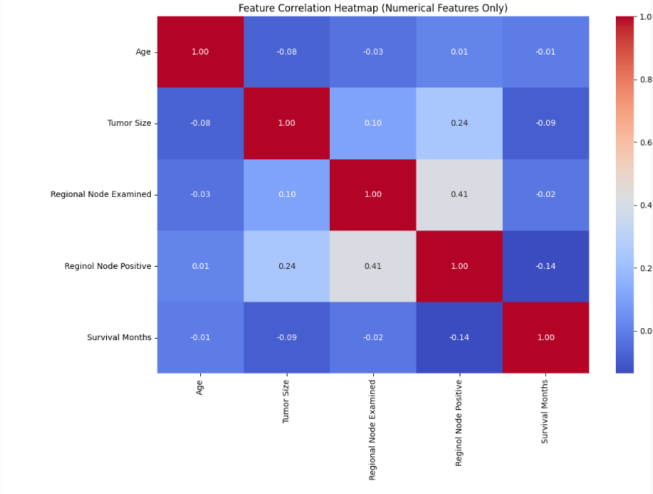
Feature Engineering
Preprocessing techniques to prepare breast cancer data for modeling, including categorical encoding, value normalization, and identification of key predictive variables.
Feature Encoding
Implemented Label Encoding for ordinal categorical variables.
Transformed Marital Status, Grade, and Progesterone Status into numerical representations.
Normalization
Applied MinMaxScaler to standardize all numeric features to [0,1] range
Ensures equal weighting during model training to prevent domination by high-magnitude variables.
Feature Importance
Identified key predictors: Age, Survival Months, N Stage, and Tumor Size.
Used SHAP values to determine feature impact on the model
predictions.

Slide 6
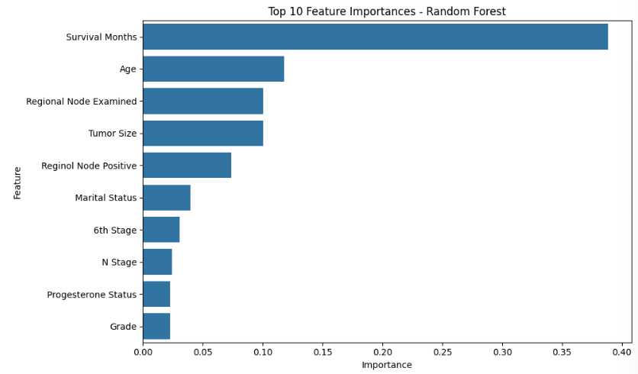
Feature Importance:
Random Forest Feature Importance:
Visual Representation: Bar plot showing feature importance score.
Key Features:
Survival Months: Highest importance, crucial for survival prediction.
Age: Significant influence on patient outcomes.
Regional Node Examined: Indicates cancer spread level.
Tumor size: Directly impacts risk and treatment decision.
Regional Node Positive: Correlates with prognosis.
Insight: Focus on survival months, age, and tumor indicators for accurate predictions.

Slide 7





Machine Learning Models
A comparison of five key classification algorithms, each with distinct approaches to pattern recognition and prediction.
Training Process
Data: 80% train, 20% validation; Min–Max scaler
Tuning: GridSearchCV for optimal parameters (e.g., learning rate, max depth)
Imbalance Handling: SMOTE(Synthetic Minority Over-sampling Technique) to balance the classes after train–test split.
Metrics: Accuracy, Precision, Recall, F1-Score, ROC-AUC
Logistic Regression
Decision Tree
XGBoost
Probabilistic classifier for binary outcomes
Hierarchical, interpretable classification model
Gradient-boosted trees with regularization
K-Nearest Neighbors
Random Forest
Robust ensemble of decorrelated decision trees
Non-parametric, instance-based classifier (K=5)

Slide 8
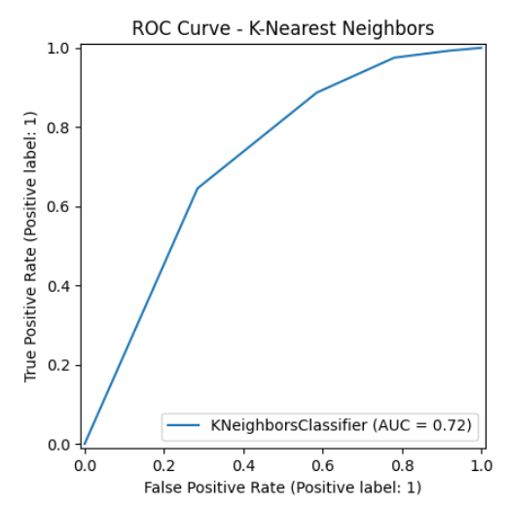
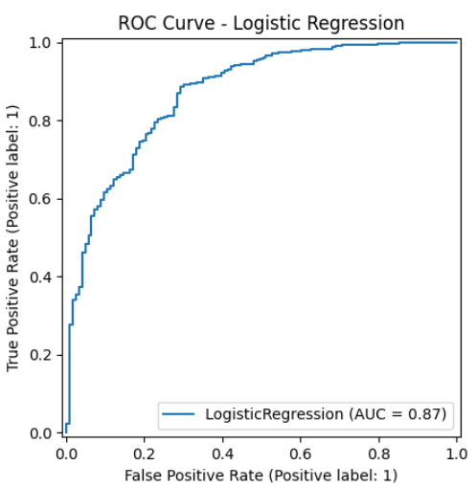
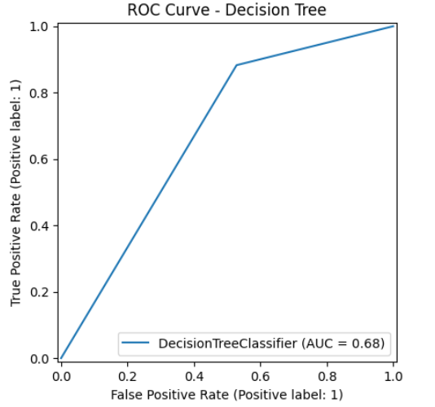
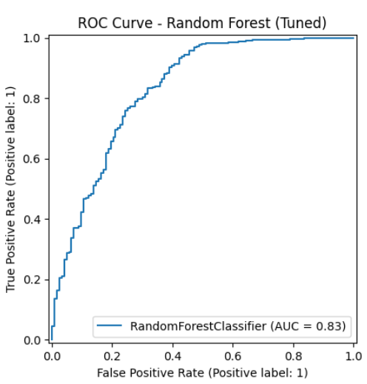
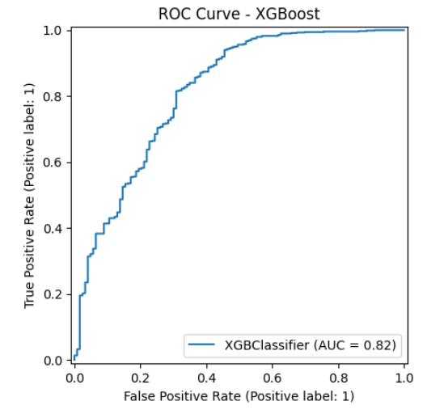
Model Evaluation Results
Model | Accuracy | Precision | Recall | F1-Score | ROC-AUC
K-NN | 0.859 | 0.873 | 0.975 | 0.921 | 0.720
Logistic Regression | 0.888 | 0.896 | 0.980 | 0.936 | 0.870
Decision Tree | 0.819 | 0.902 | 0.882 | 0.892 | 0.677
Random Forest(Tuned) | 0.906 | 0.916 | 0.979 | 0.946 | 0.829
XGBoost | 0.888 | 0.911 | 0.961 | 0.935 | 0.815
Analysis: Random Forest (Tuned) outperforms others with a higher F1-Score (0.946) and Accuracy (0.906), excelling in identifying survival status.

Slide 9
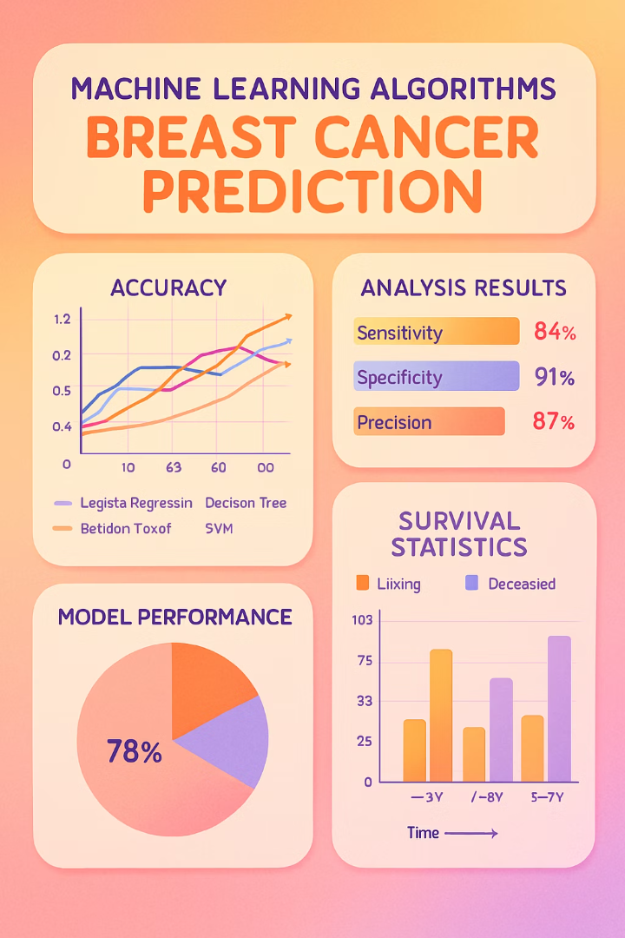
Key Insights
Random Forest outperformed other models for breast cancer prediction, with tumor characteristics and patient demographics serving as critical predictive features. Advanced techniques addressed data challenges, enabling robust clinical applications.
Model Performance
Random Forest classifier achieved highest accuracy (89.6%) with superior precision-recall balance
Critical Features
Tumor size, survival months, and patient age emerged as the most significant predictive variables
Class Imbalance
SMOTE resampling technique substantially improved sensitivity and F1-scores across all models
Clinical Application
Machine learning algorithms provide valuable decision support for early diagnosis and personalized treatment planning

Slide 10
Conclusion:
Actionable next step: Deploy the optimized Random Forest model into a clinical decision support system to assist oncologists with early prognosis and personalized treatment planning
Outcome: Achieved 94.6% F1-score with SMOTE-balanced training, enabling more accurate survival predictions for breast cancer patients
Scalability: Extend the model by incorporating genetic markers and imaging data (e.g., mammograms) for multi-modal prediction
Future direction: Explore deep learning models like CNNs for unstructured medical data and survival regression for time-based outcomes

Slide 11









Future Work & Acknowledgments
Our research will expand into genetic markers, deep learning, survival analysis, and multi-modal imaging integration to advance breast cancer prediction and treatment.
Genetic Markers
Deep Learning
Integrate genomic sequencing data to identify hereditary risk factors and personalize treatment pathways
Implement convolutional neural networks to detect subtle patterns invisible to traditional statistical methods
Imaging Data
Survival Analysis
Combine mammography, ultrasound, and MRI imaging with clinical data for comprehensive diagnostic modeling
Develop Cox proportional hazards models to predict recurrence rates and long-term patient outcomes

Slide 12


